Slide 1
Feature Emphasis and Contextual Cutaways for Multimodal Medical Visualization
Martin Haidacher Eduard Gröller
Michael Burns
Wolfgang Wein
Ivan Viola

Slide 2
Preface
CT scan with embedded Ultrasound data
Notes:
Our goal with this work is to provide a visualization that allows one to view live ultrasound data in the context of a volumetric CT scan. In doing so we need to provide a clear view of the ultrasound plane as well as certain important vasculature, and also a view of the surrounding volumetric data to provide a 3D frame of reference.

Slide 3
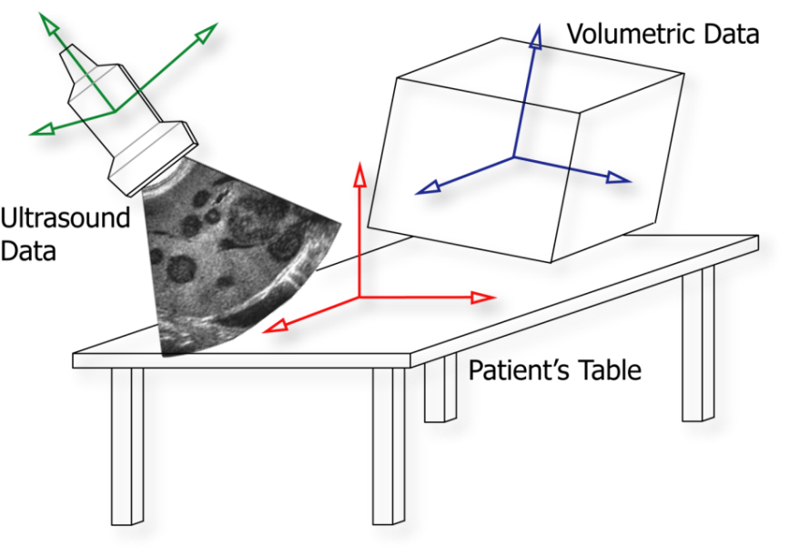
Visualization Scenario
Poking needles
Liver biopsy
Radio frequency ablation
Procedure:
Patient has CT scan
Needle path is planned
Uses ultrasound probe to help guide needle
Doctor views CT scan at time of procedure
Notes:
The techniques we present here are fairly general and could be used in several types of visualizations but we actually started this project to address a specific visualization need. Specifically, we were tasked with a way to provide more information to doctors who perform liver biopsy and radio frequency ablation. In the case of a biopsy, a needle is inserted to remove a piece of tissue for testing purposes, such as tumor diagnosis. In the case of radio frequency ablation, a needle is inserted into a tumor in order to destroy it. In either case, the doctor needs to know exactly where to place the needle in order to be effective.
The overall procedure for these needle operations begins with the patient having a CT scan, usually with contrast dye to highlight their vasculature. The doctor will then locate the target area in the CT scan and plan a needle path that minimizes damage to the surrounding organs and vessels. When it comes time to actually stick the needle in the patient, the doctor uses data from an ultrasound probe to help guide the needle to the proper location. While doing this, the doctor also needs to see the CT scan used to plan the needle path in order to make sure that critical anatomy isn’t accidentally punctured.

Slide 4
Visualization Scenario
CT Scan Data
Ultrasound Data
Notes:
Many current systems provide these 2 views to the doctor, one showing the live ultrasound data and another showing a corresponding slice from the CT data. While they’re both useful and necessary, it is difficult from these views to relate information at one point in the ultrasound data to nearby points in the CT data not shown in the corresponding slice. Furthermore, it is difficult to establish a 3D spatial relationship between the ultrasound data and the patient unless one is holding the ultrasound probe himself. Because of this, we want to show the ultrasound information in the same image as a volumetric rendering of the CT scan.

Slide 5
Visualization Scenario
Ultrasound embedded in dense volume
Notes:
We can do this by using some hybridized rendering techniques to embed the ultrasound plane in a volume but if we use a transfer function that renders all tissues in the scan, we end up with tissue completely occluding the ultrasound plane.

Slide 6
Visualization Scenario
Ultrasound embedded in sparse volume
Notes:
We can fix this by altering our transfer function to render only the vasculature of interest. So now we can see the ultrasound data as well as the surrounding vessels, but we’ve lost much of the information about the big picture, like the 3D surface of the CT scan and any other tissues or organs.

Slide 7
Visualization Scenario
Ultrasound with contextual cutaway
Notes:
We address this with our solution by combining the best of both rendering styles. In the area immediately in front of the ultrasound plane, we only show the important vasculature. In the area around that we show other tissues gradually cut away. And behind the ultrasound plane we show the complete volume rendering. Because this cutaway view is dependent on the viewing position, we’re ensured that the ultrasound plane remains visible from any viewpoint while the surrounding material provides our 3D spatial reference frame.

Slide 8
Key Requirements
Volumetric data
Tissue types differentiated and ranked
Important materials most visible
Unimportant materials provide context
Ultrasound image
Captured with 3D position and orientation of probe
Registration between coordinate frames [Wein05]
Notes:
There are several keys that we need in order to create this type of visualization. First we need to establish a ranking of various tissue types in our volumetric data. So, going back to our motivating problem, we have vasculature that we showed in blue being our most important tissue type. We also have other tissue types, such as red flesh and beige skin, being much less important. This type of ranking is something that is specified by the user, and the relative importance of each tissue should determine how much it is shown in the visualization. Important materials should be highly visible, and possibly be allowed to occlude our ultrasound plane. On the other hand, materials of low importance should not occlude our view of the ultrasound plane but should be visible in some areas to provide the overall 3D impression.
For the ultrasound image, we’re using ultrasound data captured along with the position and orientation of the probe in 3D space. This is done using a special magnetic sensor attached to the probe, which gives us a position in a coordinate frame that is arbitrarily different from the coordinate frame of the volumetric data. So we perform a one-time registration between the patient’s location, the positional sensor coordinate frame, and the coordinate frame of the volume. This is described in our previous work, which we reference in the paper. So as far as we’re concerned, we assume that for any slice of ultrasound data, we know its 3D position and shape in the volume.

Slide 9
Visualization Pipeline
Volumetric Data (e.g. CT Scan)
Viewpoint Information
Object of Interest (e.g. Ultrasound Plane)
Importance in the Transfer Function
Contextual Cutaway Views
Importance-Driven Shading
Integrating Occlusion with Importance
Notes:
Here we can see an overview of our visualization pipeline. Starting with the volumetric data, we establish our ranking of tissues by introducing an importance value to the specification of our transfer function. We then use this importance information to affect shading and emphasize tissues of interest. We then take the viewpoint information and the geometry of interest, such as the ultrasound plane, to define a special view-dependent cutaway structure. We use this structure to determine occlusion properties of tissues and use this information along with the tissue importance to create our final image.

Slide 10
Visualization Pipeline
Volumetric Data (e.g. CT Scan)
Viewpoint Information
Object of Interest (e.g. Ultrasound Plane)
Importance in the Transfer Function
Contextual Cutaway Views
Importance-Driven Shading
Integrating Occlusion with Importance

Slide 11
Defining Importance
Rank materials by relevance
Definition in volumetric space
Uses auxiliary volume
Requires preprocessing per dataset
Definition in transfer function space
Extra value in transfer function
Shared among datasets
Notes:
We want to rank our materials by their relevance to the visualization. There are several ways we can do this. One way is to provide an explicit spatial definition of importance in 3D space. One might do this by using a specialized segmentation algorithm or possibly by user painting. Either way, this requires an auxiliary volume to store the importance values for each point. Furthermore, this volume would have to be generated in a preprocessing step per dataset since the spatial definition of importance changes per CT scan.
We take a different approach, instead augmenting the transfer function with an additional component to specify the importance of the tissue represented by that component. As CT scans provide generally consistent values between scans of different patients, we only have to do this importance classification once per visualization scenario. Furthermore, because of the contrast agent, we can use the transfer function to pick out our tissues of interest.

Slide 12
Defining Importance
Component 2
Component 1
c₂, α₂, I₂
|∇F(x, y, z)|
c₁, α₁, I₁
Material boundaries
F(x, y, z)
Notes:
We’ve chosen to use a 2D transfer function based on scalar value and gradient magnitude. Looking at an abstraction of a typical histogram of gradient magnitude and scalar value, we can see how one normally identifies materials and assigns a color and opacity to each material component. This of course allows us to determine the color and opacity for each sample in the volume during rendering. By augmenting each component with an importance value I, we can then determine the importance value for each sample in the same way. I should note that this provides us with an implicit definition of importance in 3D space, which is in contrast to the explicit definition I mentioned before, but that both approaches allow one to determine an importance value for each sample being rendered.

Slide 13
Visualization Pipeline
Volumetric Data (e.g. CT Scan)
Viewpoint Information
Object of Interest (e.g. Ultrasound Plane)
Importance in the Transfer Function
Contextual Cutaway Views
Importance-Driven Shading
Integrating Occlusion with Importance

Slide 14
Feature Emphasis
Visual distinction between materials
Emphasis of important materials
Material properties
Color
Opacity
Lighting properties
Shading conveys detail
Notes:
One of the basic things we do in visualization is to provide a visual distinction between objects or materials. In order to provide emphasis of important materials, we can make certain choices in color hue or saturation to guide the user to the important parts of an image. So, we might give very bright vibrant colors to an important material and render unimportant materials in subdued, grayed colors. However another means of providing visual distinction is through shading, because shading provides detail about surface orientation and allows one to see small features like bumps and creases.

Slide 15
Feature Emphasis
Full Shading
No Shading
Notes:
If we look at these two images we can see how shading provides this detail. We have two images, with and without shading, and we can see that shading provides the detail necessary to fully comprehend certain structures, such as the overlapping tubular vessels.

Slide 16
Feature Emphasis
Full Shading
Importance Shading
Notes:
We then propose to use a mixed shading model that shades materials based on their importance. Thus, important materials will be rendered with full surface detail information and unimportant materials will be rendered without such information.

Slide 17
Feature Emphasis
Emphasis: E
Shaded color: C_{shaded}
Subdued color: C_{subdued} = E * C_{unshaded} + (1 – E) * C_{shaded}
Final color: C_{final} = I * C_{shaded} + (1 – I) * C_{subdued}
Importance Shading
Notes:
We do this by first establishing a global emphasis parameter E to control the effect of this differentiation. With full emphasis, unimportant materials are rendered completely unshaded. With no emphasis, all materials are rendered equally shaded. So we begin by calculating a shaded color using any shading model, and then calculate a subdued color as a linear blend between the shaded and unshaded colors based on the global emphasis parameter. To determine the final color of a sample, we take a linear blend between this subdued color and the fully shaded color based on the sample’s importance value.

Slide 18
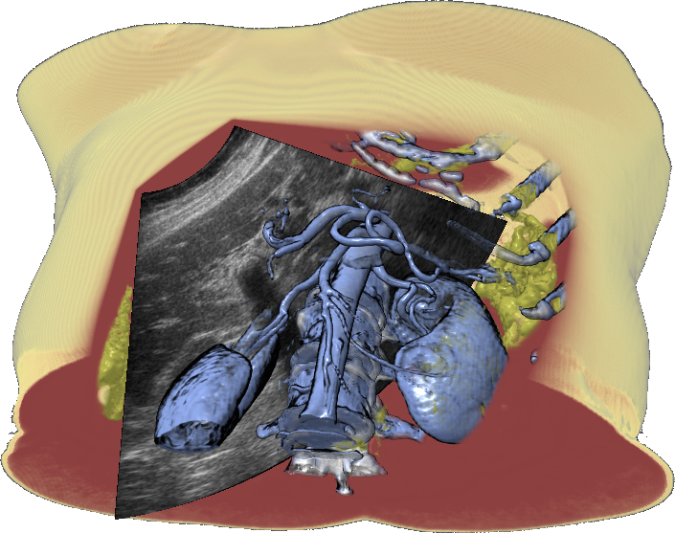
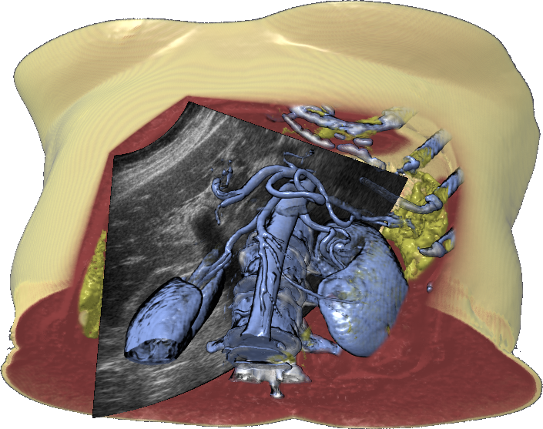
Feature Emphasis
Notes:
We see how this looks in our application by suppressing the shading in the skin and flesh regions.
*ADVANCE* for full emphasis
We can see how removing the shading information completely helps remove distracting detail in the skin and flesh and causes the vasculature to stand out.
*ADVANCE* for no emphasis
Without any emphasis, all materials are fully shaded and that detail in the flesh and skin returns.
*ADVANCE* for half emphasis
In practice, we emphasize with a value less than 100%, such that some subdued shading information is present to provide better 3D shape, but full shading is only used for the most important materials.

Slide 19
Visualization Pipeline
Volumetric Data (e.g. CT Scan)
Viewpoint Information
Object of Interest (e.g. Ultrasound Plane)
Importance in the Transfer Function
Contextual Cutaway Views
Importance-Driven Shading
Integrating Occlusion with Importance

Slide 20
Contextual Cutaways
Object of interest obscured by volume
High importance
Should be visible
May obscure object
Low importance
Not necessarily visible
May not obscure object
View-dependent cutaway structure
Notes:
Going back to the goals of our visualization, we note that materials of high importance should be prominent in the visualization and may be allowed to obscure our object of interest, the ultrasound plane. On the other hand, materials of low importance do not necessarily have to be visible, since they will serve mostly to provide a 3D frame of reference. As such, we do not want them to obscure the ultrasound plane. In order to accomplish this, we’ll use a view-dependent cutaway structure.

Slide 21
Traditional Cutaways
v
θ
Clear
Base
Object of Interest
Notes:
In the traditional cutaway view, a cut is made into the volume and around the silhouette of the object of interest at an angle theta to the view vector to remove material in front of the object of interest. This scenario then establishes two distinct regions, the clear region, which is the area being cut out, and the base region, in which the volumetric material is to be fully rendered.

Slide 22
Traditional Cutaways
Small θ
Large θ
Notes:
We can see the result of this type of cutaway in these two images. We see that the amount of material removed around the outline of the ultrasound plane depends on the angle of the cutaway. As there are only two regions defined, the clear, and the base, it is difficult to give special treatment to materials of varying importance.

Slide 23
Contextual Cutaways
v
Clear
d
Overlay
θ₁
Transition
θ₂
Base
Notes:
We define a richer, more flexible type of cutaway by establishing two additional regions, the transition and overlay regions, which we will use to convey more contextual information. We define the transition region to be the area between cutouts of two different angles, shown here as theta 1 and 2. We then define the overlay region to be the area in front of the inner cutout and the object of interest, which we show here with a thickness d. The idea is that in the transition region we will cut away materials at different angles between theta 1 and theta 2, cutting away materials of lower importance at wider angles. We will then display our most important materials in the overlay region, where they will be allowed to obscure the object of interest, up to a certain depth. We can note that when d is zero and theta 1 and theta 2 are equal, our cutaway degenerates into the traditional cutaway structure.

Slide 24
Layered Visualization
Base
Transition
Notes:
To see the benefits of adding these additional regions we will look at how they can be used to create a layered visualization. We start with the base region shown on the left, which is equivalent to that created by the traditional cutaways.
*ADVANCE*
We can then see the transition region created between the original wide cutaway angle and a narrower angle. In this region we display vasculature and bone completely while progressively trimming away skin and the yellow dense organ material.

Slide 25
Layered Visualization
Base, Transition
Overlay
Notes:
Integrating these two together, we see it adds a bit more context to our visualization, showing some of our important materials in the area next to the ultrasound plane, but not in front of the ultrasound plane. This is where our overlay region comes in.
*ADVANCE*
In this area we show the most important materials, which are allowed to obscure the ultrasound plane, up to a certain thickness. In our motivating scenario, this would allow the doctor to view important vasculature immediately in front of the ultrasound plane.

Slide 26
Layered Visualization
Base, Transition, Overlay
Base
Notes:
By integrating the overlay region we see our complete layered visualization.
*ADVANCE*
We can compare this to the visualization of the base region alone and see how much additional information can be provided by incorporating the transition and overlay regions.

Slide 27
Visualization Pipeline
Volumetric Data (e.g. CT Scan)
Viewpoint Information
Object of Interest (e.g. Ultrasound Plane)
Importance in the Transfer Function
Contextual Cutaway Views
Importance-Driven Shading
Integrating Occlusion with Importance

Slide 28
Occlusion
v
1
Ω = 1
0.75
0.5
0.25
0
Ω = 0
Notes:
We define a function, omega, within our cutaway structure to provide some measure of how much a point is occluding our object of interest. We define this occlusion function to be zero in the base region, since the base region is never occluding the object of interest, and 1 in the clear region, since this is the innermost area of the cutaway. The occlusion function varies in the transition region, from 0 to 0.5, such that values in between represent cutaway surfaces with angles between the bounding angles, theta 1 and theta2. So we can see, for example, that a cutaway surface with an angle halfway between theta 1 and theta 2 lies where omega is 0.25. This linear variation of omega within the transition region is what allows us to cut away materials at varying angles. We then see that the overlay region defines the upper half of the occlusion range, from 0.5 to 1. And this is where we can display material that is allowed to obscure the region of interest.

Slide 29
Occlusion Compensation
Fade material based on occlusion value between two occlusion thresholds
Thresholds based on importance
Modify opacity:
τ_{u} = I
τ_{l} = max(2 * I – 1, 0)
α’ = α * (1 – ramp(τ_{u}, τ_{l}, Ω))
Notes:
The idea is then to fade a rendered sample based on the occlusion value for that point in 3D space. We do this by performing a linear fade between two occlusion thresholds, which are based on importance. So we establish these two thresholds, tau u and tau l, and we multiple the opacity of the sample by a linear ramp evaluated at omega between the two thresholds.

Slide 30
Occlusion Compensation
Base
Transition
Overlay
Clear
1
α scale factor
Liver (0.5)
Vessels (0.99)
Flesh (0.01)
0
0
0.5
1
Occlusion value (Ω)
τ_{u} = I
τ_{l} = max(2 * I – 1, 0)
Notes:
We see in this graph just how this works for 3 different tissue types in our visualization. The 4 regions of the cutaway structure are labeled along with their occlusion value boundaries at 0, 0.5, and 1. Starting at the lower left, we see that the red flesh, which is given a very low importance value of 0.01, is basically visible only in the base region, fading out very quickly in the transition region. Some of the liver and other organ tissue, shown in yellow, is given a moderate importance value of 0.5, such that it gradually fades throughout the transition region until it is made completely transparent in the overlay and clear areas. Looking at the vessels, in blue, these have a very high importance value of 0.99, so they’re only faded out in the very edge of the overlay area. If we set the importance to 1, the material would then be rendered in the clear area as well.

Slide 31
Results
No cutaway
(over draw)
Notes:
With all this in mind, we can now take a look at some results and hopefully understand what’s going on. On the left you can see some videos captured with our system, and on the right you can see a corresponding diagram of the cutaway structure.
Here we see the effect of using a cutaway with an angle of zero, which is visually the same as not having a cutaway and just rendering the ultrasound plane on top of the volume.

Slide 32
Results
Simple cutaway
Notes:
We can introduce a moderate cutaway angle to allow us to see where in the volume this ultrasound plane is embedded.
We thus have a clear region and a base region, but we’re not yet making any differentiation between different materials.
We can partially address this by rendering our most important material in the clear region.

Slide 33
Results
Simple cutaway with interior
Notes:
We are then allowed to see all of the vasculature in front of the ultrasound plane, but note that there can be so much shown that it may overly occlude our view of the ultrasound plane.

Slide 34
Results
Interior becomes overlay region
Notes:
To address this, we convert this clear region into an overlay region with a small thickness.
This frees up some clutter in the interior of the cutaway and clearly shows which material is closest to the ultrasound plane.

Slide 35
Results
Transition area added
Notes:
In order to view some of the surrounding material freed of the occluding flesh, we can create a transition area.
And here we see the full scope of the visualization with all of the cutaway regions added.
Notice how the cutaway structure changes as the object is rotated, keeping consistent with the current viewing direction.

Slide 36
Results
Notes:
We can look at some more results using our system. We begin by showing a sweep with some typical angle parameters set and an arbitrarily large thickness for the overlay region.
We then shrink the overlay region so that only the area in front of the ultrasound is visible.
We then collapse the transition region by decreasing the outer cutaway angle until it equals the inner cutaway angle.
And finally we increase the overlay thickness so that all material is visible.

Slide 37
Implementation
GPU Raycaster in GLSL
Cutaway represented as height field
Created by rendering extruded geometry
Requires only 1 lookup per ray
Performance
Interactive frame rates
10-15 fps on high-end hardware
Dependent on sample rate, volume size, empty space skipping, etc.
Notes:
We implemented the volume renderer as a GPU raycaster in GLSL. And our cutaway surface is created by rendering extruded surfaces from the ultrasound silhouette at two angles. We render this into a screen aligned height field, which we use during raycasting to compute the cutaway boundaries using only 1 lookup per ray.
As far as performance goes, we’re currently achieving interactive frame rates, at about 10 to 15 frames per second on some high end but commodity graphics hardware. Of course performance is heavily dependent on sample rate, volume size, and a few other parameters, so in practice we’ve gotten this up to 30fps by rendering at a low resolution like 512^2 and using a sample rate of one sample per voxel. In these images and movies we use double the sample rate to avoid any aliasing.

Slide 38
Conclusions
Visualization
Material importance defined within transfer function
Important materials emphasized through shading
View-dependent cutaway structure determines occlusion of object-of-interest
Materials removed in occluding areas, according to their importance
Application
Visualize ultrasound data within CT scan for needle driven operations
Initial feedback has been positive
Currently being evaluated for clinical use
Notes:
Looking back on the visualization method, we’ve seen how material importance can be defined within the transfer function, how important materials can be emphasized by shading modulation, how a view-dependent cutaway structure can provide a notion of occlusion for volumetric material around an object of interest, and how this material can be removed in occluding areas, according to their importance.
These techniques were of course developed to support an application, of visualizing ultrasound data within the context of a CT scan for operations such as liver biopsy and radio frequency ablation. We’ve shown this work to a couple doctors in detail, and they’ve acknowledged the potential for this type of visualization to be used in clinical settings. In the next few months we will probably be deploying a version of this visualization system to a clinical site in the US sponsored by Siemens. Once this is done, the system will be evaluated in more depth for clinical use.

Slide 39
Acknowledgments
Gianluca Paladini
Siemens Corporate Research
Adam Finkelstein
Princeton University
Paper reviewers
EuroVis 2007 hosts

